Slide 1
Questions

Slide 2

How many surgery sessions should trainees be having?
Enter Text and Press Send
Vote Trigger
Notes:
7
1 x HDR
1 x tutorial 4h
1 x SDL

Slide 3
How much time should be protected for debrief time after a surgery?
Does it depend on how experienced they are i.e. ST3 need less than ST1/2?
Enter Text and Press Send
Vote Trigger
Notes:
20 mins min
20-30 is the norm
Provided for all trainees – irrespective of stage. There is always some learning to be done.

Slide 4
How much tutorial time should a full-timer get?
Part-time trainees: how much should they get?
Enter Text and Press Send
Vote Trigger
Notes:
4 h
Pro rata for part-timers
But give more if they need it eg struggling training

Slide 5
How many hours of Self-Directed Learning time should trainees get per week?
Should it be build into their weekly rota or just fit it in opportunistically every few weeks?
Enter Text and Press Send
Vote Trigger
Notes:
4h
Yes build it in

Slide 6
The slow consulting trainee… how do we speed them up? Any techniques? How do we encourage better time management?
Enter Text and Press Send
Vote Trigger
Notes:
Data gather, Investigate and Diagnose before you treat.
If nothing spectacular and a clinically good, just reduce the time. It will make them speed up and find faster routes to what they are already doing.

Slide 7
We have a doctor-led triaging system.
Does this negatively or positively impact GP training?
Enter Text and Press Send
Vote Trigger
Notes:
With a doctor-led triaging system, those that need to be seen are sieved out. So anyone that needs seeing generally needs seeing and something doing.
The GP trainee might not get exposure to
- Differentiating between those need seeing and those that don’t
- Reassurance skills
Advising self-care skills
One positive effect of this is that most people seen will need some sort of action. And therefore GP trainees get less chaff and more wheat – which is good for the CSA. The CSA is rarely ever simple.
Solution? Get them to do the triaging too.

Slide 8
When will the new changes to the ePortfolio happen.
Enter Text and Press Send
Vote Trigger
Notes:
Changes are already in place – curriculum, prescribing, QIA, UUSC, ES changes
More to come like the FourteenFish, new grades.

Slide 9
What will the new ePortfolio look like?
Notes:
See next slide.
Looks fab doesn’t it

Slide 10
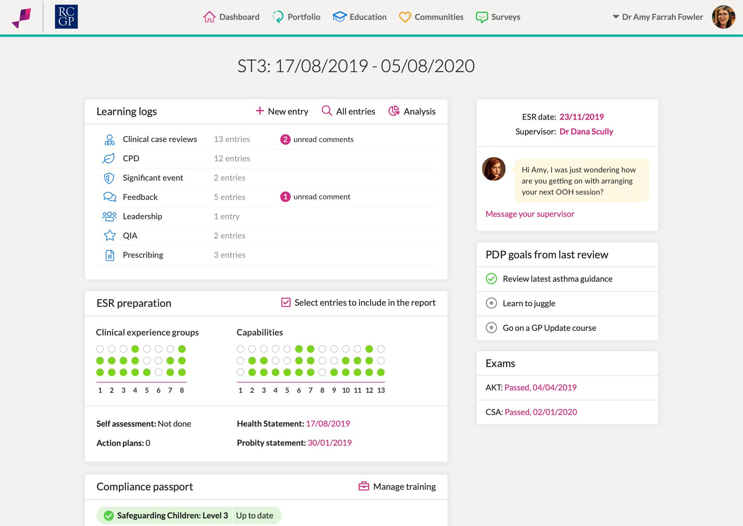

Slide 11
How many log entries per week should a FT be doing?
What if they are part-time eg 60%?
Any tips to encourage them to do more reflective ones?
Enter Text and Press Send
Vote Trigger
Notes:
2 per week
1 per week
See www.bradfordvts.co.uk – Ram’s easy log entries – focus on the capability first

Slide 12
What’s the difference between capability and competence?
Why the move to capability?
Notes:
Competence tells you what you can do but not whether you can do it in a variety of settings.
Capability tells you how good you are across a range of settings.
Competence in Communication Skills might just be adults
Capability implies good across a range of people – like language barrier, elderly, young, children, women, men, LGBTQ etc

Slide 13
Educator’s Notes: how do people use them?
Does the new GDPR rules affect this in anyway?
Notes:
Positive things
esp if trying to encourage the unconfident trainee
If trying to show improvement to an ARCP panel for a struggling trainee
Positive on the hoof feedback from colleagues
Positive unexpected behaviours from the trainee eg helping other doctors out when running late
Negative
If trying to get the trainee to “listen”
To document things with clarity in case the sh*t hits the fan – and so everyone who needed to know was in the know (including the trainee)
If trying to highlight the ES or ARCP something – eg poor eP engagement
Neutral
Some record a plan of what they are doing in tutorials

Slide 14
What are the most frequent mistakes you see trainers make or that you have made as a trainer?
Notes:
Prejudging the trainee when things go wrong!
Prejudging the trainee even when things don’t go wrong!
Labelling the trainee unfairly eg lazy, not interested, doesn’t go the extra mile
Do not make conclusions from observations. Always explore.
The second thing….
Not teaching them what reflection is.
Not teaching them how to do reflective learning log entries.
Is it because they don’t know themselves?
The third thing…
Not understanding the PCs.
Know your definitions well.
The fourth thing
Always assuming difficult trainees are a nightmare. Not wanting to take them on. Only wanting good trainees.
Even a colleague asked me if I would take on a trainee before we had come to know him. Just because he had a foreign sounding name! And he wanted to swap for the other trainee who clearly had an English name. Turns out the ‘foreign’ sounding name was pretty good.

Slide 15
OOH – how many hours do they need to do over the whole GP training period?
Enter Text and Press Send
Vote Trigger
Notes:
It’s called UUSC
No longer hours based
Although can’t show the 5 capabilities with less than 48h
ST1/2 – observational & direct supervision
ST3 – direct & indirect supervision
Most displayed in ST3.
All sorts of of UUSC count – duty doctor and OOH will form most of the evidence.

Slide 16
Is a QIA project a compulsory part of GP training?
Does it need to be handed into NIMDTA
Is it in ST3 that they have to do it?
Enter Text and Press Send
Vote Trigger
Notes:
Yes compulsory
No, not to NIMDTA, but the GP trainee should look and assess it and provide advice.
No ST1 is advised.

Slide 17
Is the prescribing assessment a compulsory thing?
Can they do it in ST1?
Why do we have to do this? What’s the purpose? & How much time? Can I delegate it to someone else?
Enter Text and Press Send
Vote Trigger
Notes:
Yes compulsory
No, ST3. They won’t have had the exposure or experience in ST1/2
Medication errors are number 1 killer of patients! That’s why. Reports I think show there is an error in 1 in 15 prescriptions. However, most of these errors are minor is what others say and never materialise into anything. Some believe the Prescribing Assessment of just 20 is not the way.
How much time – 3h – a tutorial time. Trainee does all the prep work.
Delegate to another partner or in house pharmacist.

Slide 18
Is there a rule about how long before trainees can sit the CSA exam?
When should they sit it?
When should they do the AKT?
Enter Text and Press Send
Vote Trigger
Notes:
CSA – not until ST3
The AKT can be taken during or after the ST2 stage of GP training
Some say AKT should be done in ST3 too – do both together at the same time… knowledge all up to scratch – why do that twice?

Slide 19
Trainer’s resources - where should I go?
Enter Text and Press Send
Vote Trigger

Slide 20
Trainer’s resources - where should I go?
www.bradfordvts.co.uk of course.
Did you need to ask?
What else would I say?
Online resources – consultation skills or teaching sections
Direct TRAINER’S page being developed
Updated to new assessments
Notes:
www.bradfordvts.co.uk of course

